Slide 1

Week # 11
Operations Research
(Software Engineering)

Slide 2
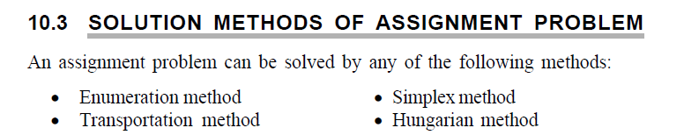
Assignment problem
The assignment problem is a special type of transportation problem where the objective is to minimize the cost or maximize the profit of the given problem.
Assumption in Assignment problem:
Number of jobs = Number of Machine or person
Each person or machine is assigned only one job

Slide 3
Assignment problem
Each person is independently capable of handling any job to be done.
Assigning criteria is clearly specified (minimizing cost or maximizing (profit).
We use Hungarian method to solve assignment problem.
Feasible solution in Hungarian method
If there are ‘n’ number of jobs given to ‘n’ different person’s then it is called feasible solution in Hungarian method.

Slide 4
Hungarian method(Balanced problem)
Minimization Problem
J = Jobs
P = Persons
 | P1 | P2 | P3 | P4
J1 | 5 | 9 | 3 | 6
J2 | 8 | 7 | 8 | 2
J3 | 6 | 10 | 12 | 7
J4 | 3 | 10 | 8 | 6

Slide 5
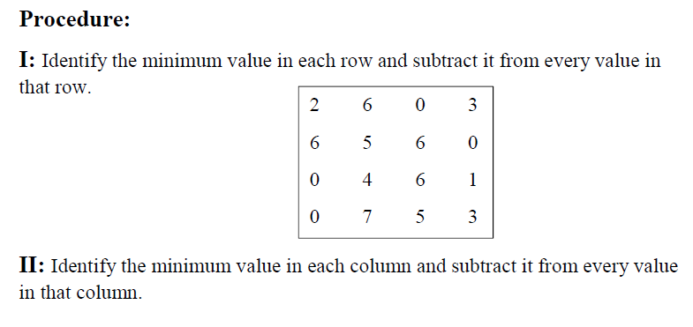
Hungarian method(Balanced problem)

Slide 6
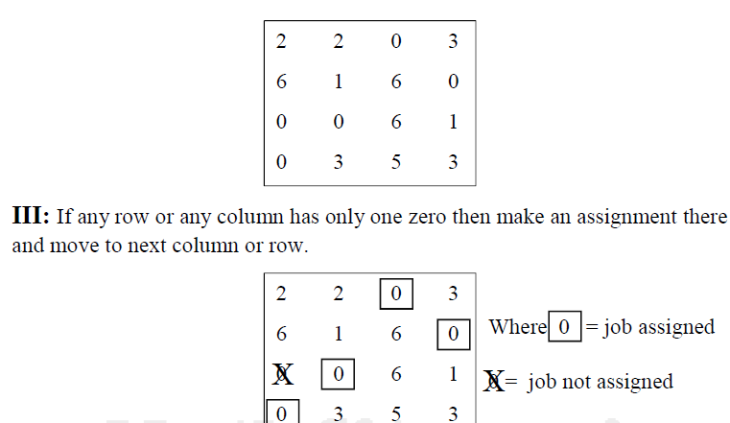
Hungarian method(Balanced problem)
No of assignments=No of rows (Optimal Solution)
Minimum solution = 3+2+10+3 = 18

Slide 7
Hungarian method(Balanced problem)
(a) First round for making assignments
Identify rows successively from top to bottom until a row with exactly one zero element is found.
Make an assignment to this single zero by making a square (􀂅) around it. Then cross off (×) all other zeros in the corresponding column.
Identify columns successively from left to right hand with exactly one zero element that has not been assigned. Make assignment to this single zero by making a square (􀂅) around it and then cross off (×) all other zero elements in the corresponding row.
(b) Second round for making assignments
If a row and/or column has two or more unmarked zeros and one cannot be chosen by inspection, then choose zero element arbitrarily for assignment.

Slide 8
Hungarian method(Balanced problem)
Minimization Problem
T = Teacher
S = Subject
 | S1 | S2 | S3 | S4
T1 | 2 | 10 | 9 | 7
T2 | 15 | 4 | 14 | 8
T3 | 13 | 14 | 16 | 11
T4 | 3 | 15 | 13 | 8

Slide 9
Hungarian method(Balanced problem)
I: Identify the minimum value in each row and subtract it from every value in that row.
 | S1 | S2 | S3 | S4
T1 | 0 | 8 | 7 | 5
T2 | 11 | 0 | 10 | 4
T3 | 2 | 3 | 5 | 0
T4 | 0 | 12 | 10 | 5

Slide 10
Hungarian method(Balanced problem)
II: Identify the minimum value in each column and subtract it from every value in that column
 | S1 | S2 | S3 | S4
T1 | 0 | 8 | 2 | 5
T2 | 11 | 0 | 5 | 4
T3 | 2 | 3 | 0 | 0
T4 | 0 | 12 | 5 | 5

Slide 11
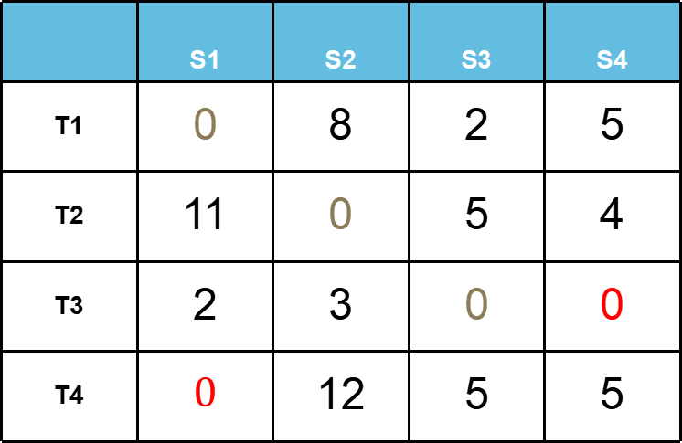
Hungarian method(Balanced problem)
If any row or any column has only one zero then make an assignment there and move to next column or row.
 | S1 | S2 | S3 | S4
T1 | 0 | 8 | 2 | 5
T2 | 11 | 0 | 5 | 4
T3 | 2 | 3 | 0 | 0
T4 | $$0$$ | 12 | 5 | 5

Slide 12
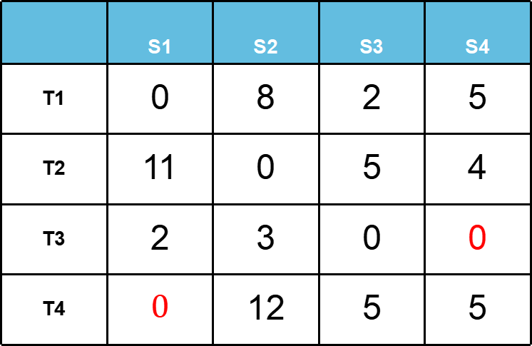
Hungarian method(Balanced problem)
Now applying a different approach
 | S1 | S2 | S3 | S4
T1 | 0 | 8 | 2 | 5
T2 | 11 | 0 | 5 | 4
T3 | 2 | 3 | 0 | 0
T4 | $$0$$ | 12 | 5 | 5

Slide 13
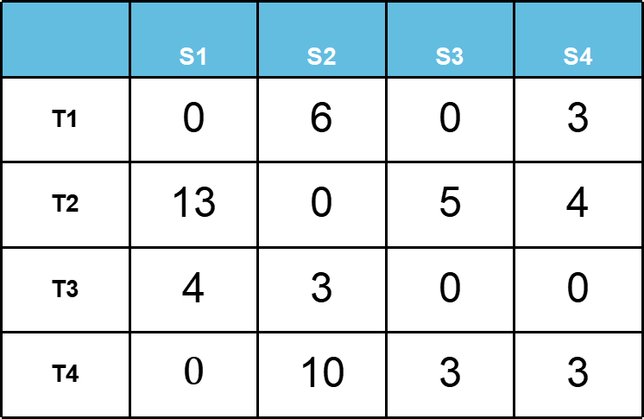
Hungarian method(Balanced problem)
The value which have been not marked and among them is lowest value 2. Subtract 2 from the values which have not been used and add 2 to the values which have been intersected.
 | S1 | S2 | S3 | S4
T1 | 0 | 6 | 0 | 3
T2 | 13 | 0 | 5 | 4
T3 | 4 | 3 | 0 | 0
T4 | $$0$$ | 10 | 3 | 3

Slide 14
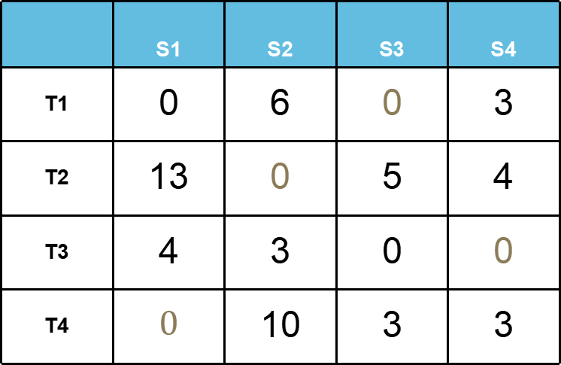
Hungarian method(Balanced problem)
 | S1 | S2 | S3 | S4
T1 | 0 | 6 | 0 | 3
T2 | 13 | 0 | 5 | 4
T3 | 4 | 3 | 0 | 0
T4 | $$0$$ | 10 | 3 | 3

Slide 15
Hungarian method(Balanced problem)
 | hrs
T1- S3 | 9
T2- S2 | 4
T3-S4 | 11
T4-S1 | 3
Minimum Solution=9+4+11+3=27

Slide 16
Hungarian method(Balanced problem)
Find maximum solution of the following Assignment problem.
 | S1 | S2 | S3 | S4 | S5
T1 | 30 | 37 | 40 | 28 | 40
T2 | 40 | 24 | 27 | 21 | 36
T3 | 40 | 32 | 33 | 30 | 35
T4 | 25 | 38 | 40 | 36 | 36
T5 | 29 | 62 | 41 | 34 | 39

Slide 17
Hungarian method(Balanced problem)
Here the highest value is 62. So, we subtract each value from it
 | S1 | S2 | S3 | S4 | S5
T1 | 32 | 25 | 22 | 34 | 22
T2 | 22 | 38 | 35 | 41 | 26
T3 | 22 | 30 | 29 | 32 | 27
T4 | 37 | 24 | 22 | 26 | 26
T5 | 33 | 0 | 21 | 28 | 23

Slide 18
Hungarian method(Balanced problem)
Identify the minimum value in each row and subtract it from every value in that row.
 | S1 | S2 | S3 | S4 | S5
T1 | 10 | 3 | 0 | 12 | 0
T2 | 0 | 16 | 13 | 19 | 4
T3 | 0 | 8 | 7 | 10 | 5
T4 | 15 | 2 | 0 | 4 | 4
T5 | 33 | 0 | 21 | 28 | 23

Slide 19
Hungarian method(Balanced problem)
Identify the minimum value in each column and subtract it from every value in that column
 | S1 | S2 | S3 | S4 | S5
T1 | 10 | 3 | 0 | 8 | 0
T2 | 0 | 16 | 13 | 15 | 4
T3 | 0 | 8 | 7 | 6 | 5
T4 | 15 | 2 | 0 | 0 | 4
T5 | 33 | 0 | 21 | 24 | 23

Slide 20
Hungarian method(Balanced problem)
If any row or any column has only one zero then make an assignment there and move to next column or row.
 | S1 | S2 | S3 | S4 | S5
T1 | 10 | 3 | 0 | 8 | 0
T2 | 0 | 16 | 13 | 15 | 4
T3 | 0 | 8 | 7 | 6 | 5
T4 | 15 | 2 | 0 | 0 | 4
T5 | 33 | 0 | 21 | 24 | 23

Slide 21
Hungarian method(Balanced problem)
.
 | S1 | S2 | S3 | S4 | S5
T1 | 10 | 3 | 0 | 8 | 0
T2 | 0 | 16 | 13 | 15 | 4
T3 | 0 | 8 | 7 | 6 | 5
T4 | 15 | 2 | 0 | 0 | 4
T5 | 33 | 0 | 21 | 24 | 23

Slide 22
Hungarian method(Balanced problem)
.
 | S1 | S2 | S3 | S4 | S5
T1 | 14 | 3 | 0 | 8 | 0
T2 | 0 | 12 | 9 | 11 | 0
T3 | 0 | 4 | 3 | 2 | 1
T4 | 19 | 2 | 0 | 0 | 4
T5 | 37 | 0 | 21 | 24 | 23

Slide 23
Hungarian method(Balanced problem)
.
 | S1 | S2 | S3 | S4 | S5
T1 | 14 | 3 | 0 | 8 | 0
T2 | 0 | 12 | 9 | 11 | 0
T3 | 0 | 4 | 3 | 2 | 1
T4 | 19 | 2 | 0 | 0 | 4
T5 | 37 | 0 | 21 | 24 | 23

Slide 24
Hungarian method(Balanced problem)
.
T1-S3 | 40
T2-S5 | 36
T3-S1 | 40
T4-S4 | 36
T5-S2 | 62
Maximum Solution=40+36+40+36+62

Slide 25
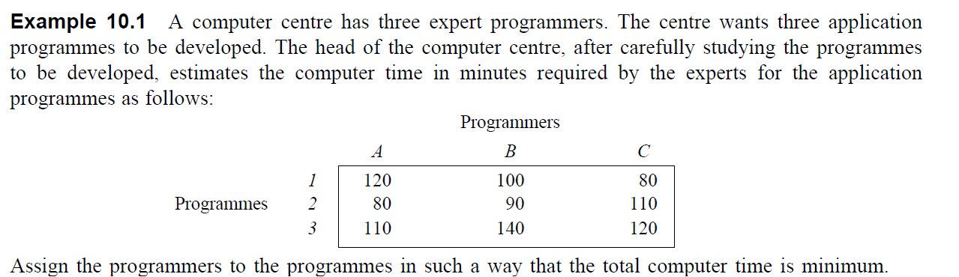

Slide 26
Practice Exercises
Example 10.2, 10.3, 10.4, 10.5

Slide 27
Thank you!

